Slide 1

Fundamentals of IT
BIT-01 BBA-Ist year MMMUT, Gorakhpur
A
PDF on UNIT-2
Data & Information

Slide 2
Data & Information
Data is any collection of numbers, characters or other symbols that has been coded into a format that can be input into a computer and processed.
Data on its own has no meaning, or context.
It is only after processing by a computer that data takes on a context and becomes information.
Information is a data put into context. Information is utilised by humans in some significant way. A good example of information would be a computer. A computer uses programming scripts, formulas, or software applications to turn data into information.

Slide 3
Data
Data can be defined as a representation of facts, concepts, or instructions in a formalized manner, which should be suitable for communication, interpretation, or processing by human or electronic machine.
Data is represented with the help of characters such as alphabets (A-Z, a-z), digits (0-9) or special characters (+,-,/,*,<,>,= etc.)
What is Information?

Slide 4
Information
Information is organized or classified data, which has some meaningful values for the receiver. Information is the processed data on which decisions and actions are based.
For the decision to be meaningful, the processed data must qualify for the following characteristics −
Timely − Information should be available when required.
Accuracy − Information should be accurate.
Completeness − Information should be complete.

Slide 5
Digital representation of Information
The data representations used in modern computer systems all fall into this family. Their fundamental property is they represent information indirectly: physical phenomena are used to represent sequences of binary digits (zero or one), and sequences of binary digits are then interpreted as integers, real numbers, characters, or other “primitive” data types.
The fundamental property of digital representations is that they are based on the use of a finite number of discrete symbols to represent information.

Slide 6
Digital representation of Information
Finite systems can represent only a finite number of symbols, in any such system there is only a finite number of possible meaningful states; this is a fundamental difference between digital and analog representations of information.
In digital systems, the physical similarity of two representations of information is no guide to the similarity of the information they represent. (For example, the bit sequences 0000 0000 and 1000 0000 differ only in the value of a single bit, but if they are taken as unsigned integers, they denote 0 and 128; many numbers much closer to zero than 128 have representations very different from either.)

Slide 7
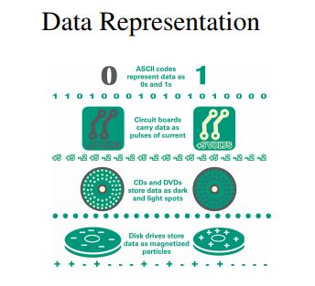
Data Representation
• The 0s and 1s used to represent digital data are referred to as binary digits — from this term we get the word bit that stands for binary digit. • A digital file, usually referred to simply as a file, is a named collection of data that exits on a storage medium, such as a hard disk, CD, DVD, or flash drive.

Slide 8
Number Systems and Comparisons

